Slide 1
딥러닝 이론 교육
딥러닝 활용 기술
Joonhyeon Park <junpark25@ajou.ac.kr>

Slide 2
Summary

Slide 3
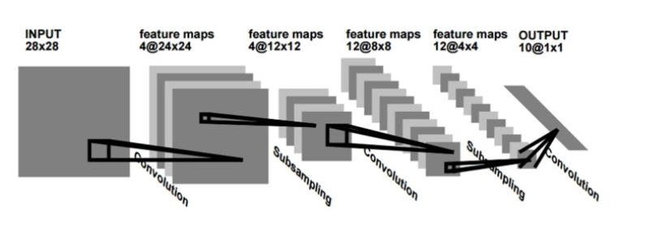
Convolution Neural Network - LeNet
1998

Slide 4
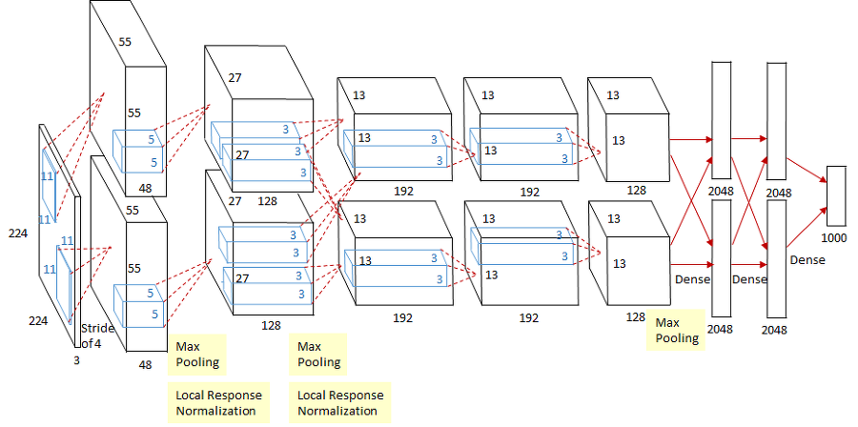
Convolution Neural Network - AlexNet
2012

Slide 5
Convolution Neural Network – AlexNet
Activation Function - ReLu
a
b
c
x
y
F(x)
G(x)
H(x)
Y=H(G(F(x))) = a ∙ b ∙ c ∙ x

Slide 6
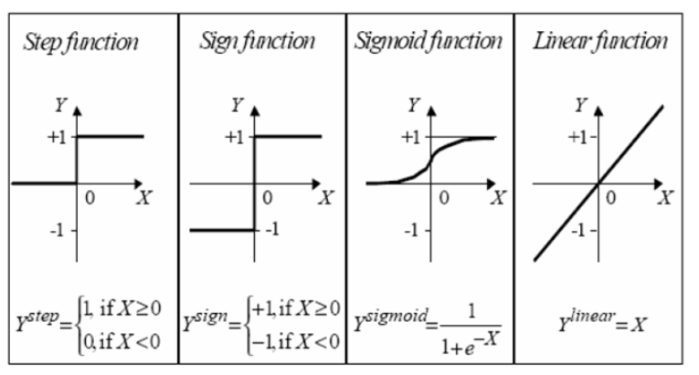
Convolution Neural Network – AlexNet
Activation Function - ReLu

Slide 7
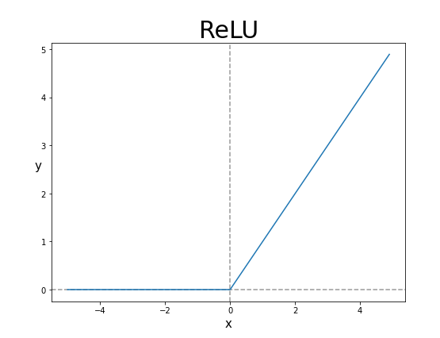
Convolution Neural Network – AlexNet
Activation Function - ReLu

Slide 8
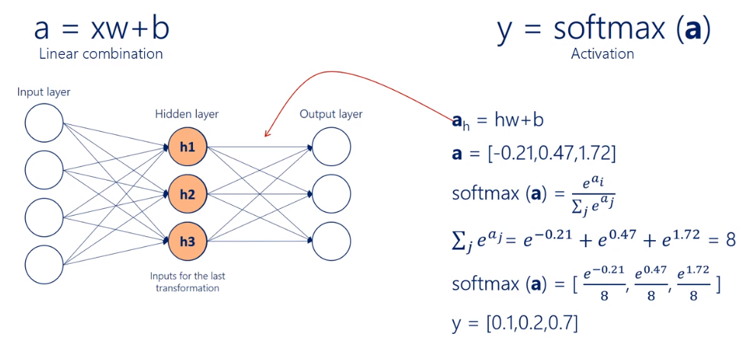
Convolution Neural Network – AlexNet
Activation Function - Softmax

Slide 9
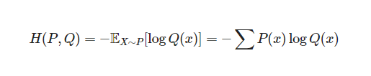
Convolution Neural Network – AlexNet
Cost Function = Loss Function
Cross-Entropy Loss

Slide 10
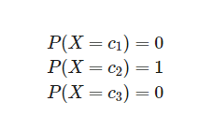
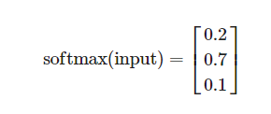
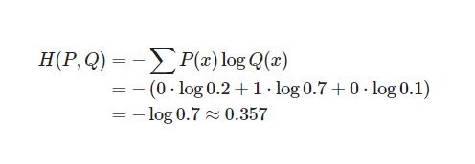
Convolution Neural Network – AlexNet
Cost Function = Loss Function
Cross-Entropy Loss

Slide 11
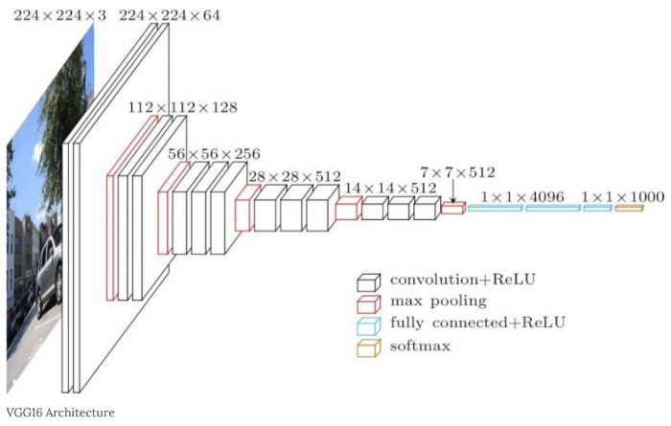
Convolution Neural Network – VGG16
2014

Slide 12
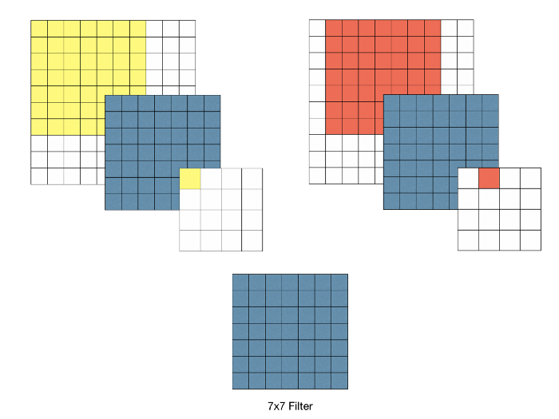
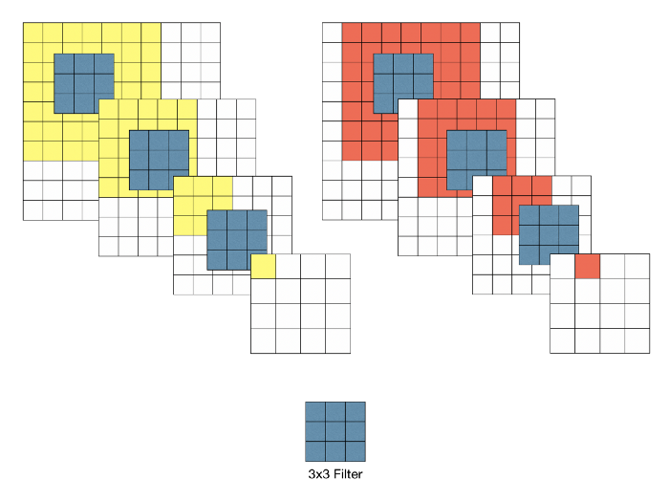
Convolution Neural Network – VGG16
7x7 filter vs 3x3 filter
Weight = 49
Weight = 9 x3 =27

Slide 13
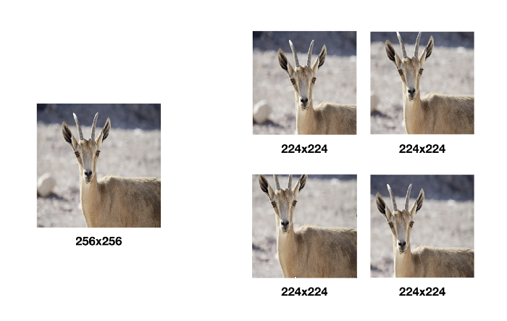
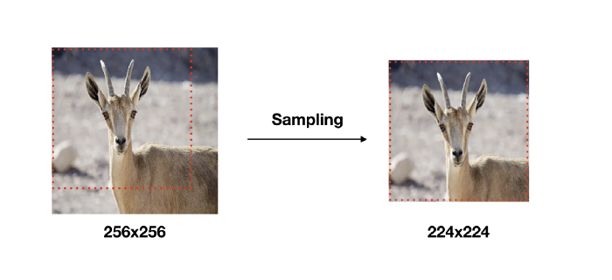
Convolution Neural Network – VGG16
Data Augmentation

Slide 14
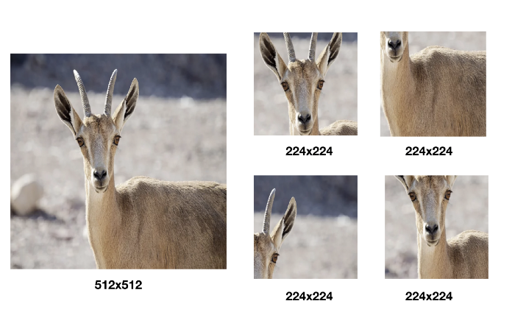
Convolution Neural Network – VGG16
Data Augmentation

Slide 15
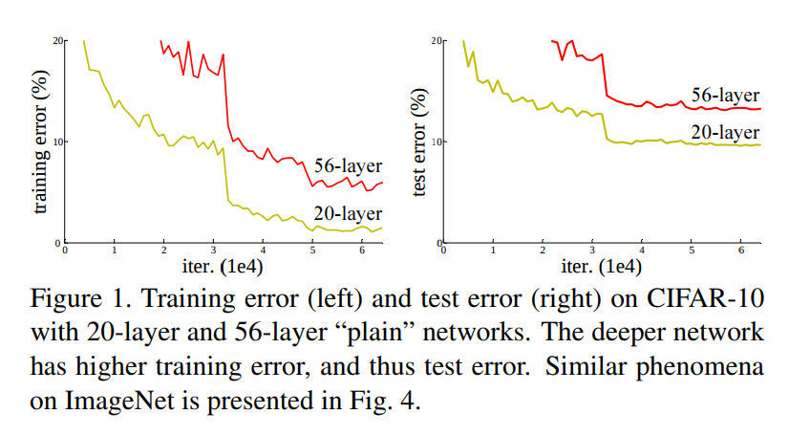
Convolution Neural Network – ResNet
Degradation Problem

Slide 16
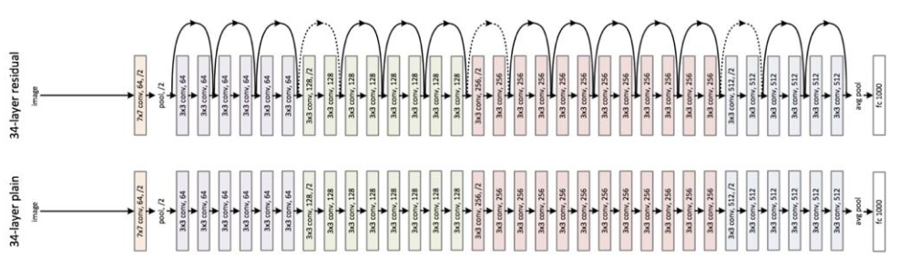
Convolution Neural Network – ResNet
2015

Slide 17
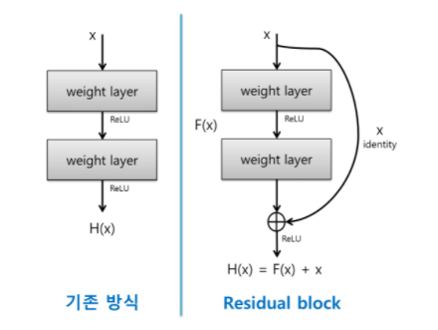
Convolution Neural Network – ResNet
Residual = Skip Connection

Slide 18
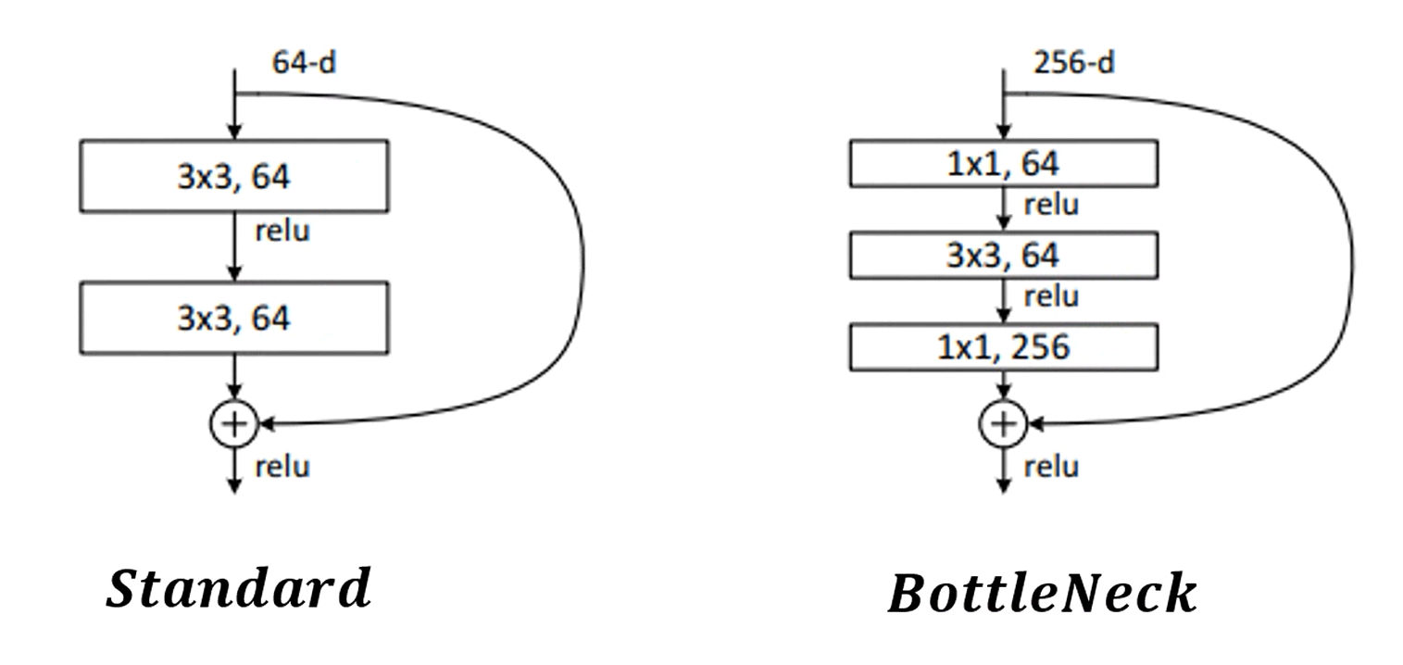
Convolution Neural Network – ResNet
BottleNeck

Slide 19
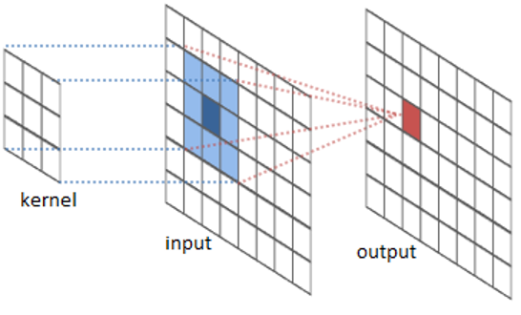
Convolution Neural Network Computation

Slide 20
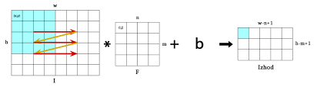
Convolution Neural Network Computation

Slide 21
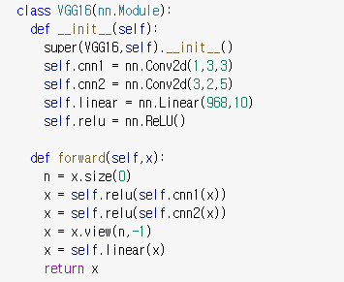
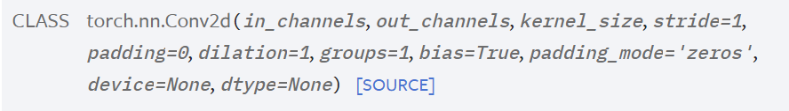
Convolution Neural Network Computation
nn.Conv2d(1,3,3)

Slide 22
Convolution Neural Network Computation
nn.Conv2d(1,3,3)
Output Channel 3
Input Channel 1
Weight (3x3)
I1 X W1
W1
I1
I1 X W2
W2
I1 X W3
w3

Slide 23
Convolution Neural Network Computation
nn.Conv2d(3,2,5)
Input Channel 3
Weight (5x5)
I1 X W(1,1)
I1
W(1,1)
W(1,2)
I1 X W(1,2)

Slide 24
Convolution Neural Network Computation
nn.Conv2d(3,2,5)
Input Channel 3
Weight (5x5)
I2 X W(2,1)
I2
W(2,1)
W(2,2)
I2 X W(2,2)

Slide 25
Convolution Neural Network Computation
I1 X W(1,1)
I1 X W(1,2)
O1
O2
……….
……….
Sum
Sum
I5 X W(5,1)
I5 X W(5,2)

Slide 26
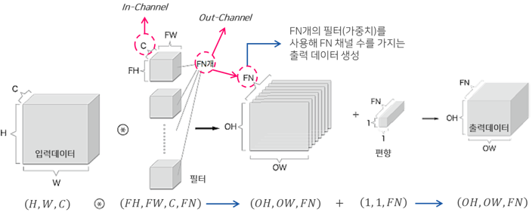
Convolution Neural Network Computation
https://excelsior-cjh.tistory.com/180

Slide 27
Convolution Neural Network
# of Parameters
Name | Input | Weight | Bias | Output
cnn1 | 22x22x1 | (3x3)x1x3 | 3 | 22x22x3
cnn2 | 22x22x3 | (5x5)x3x2 | 2 | 22x22x2
linear | 968 | 968x10 | 10 | 10

Slide 28
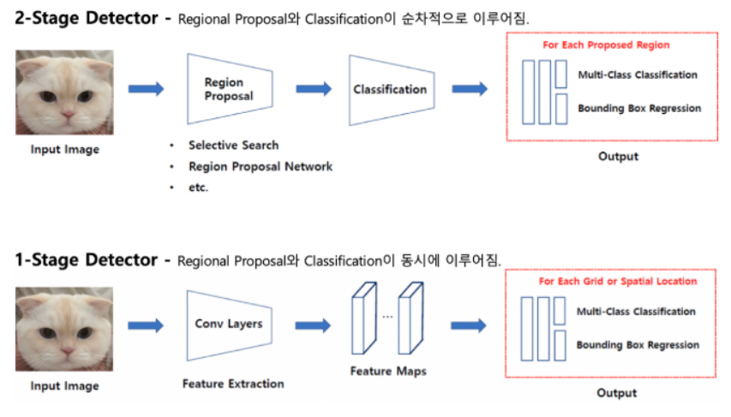
CNN Applications
Object Detection

Slide 29
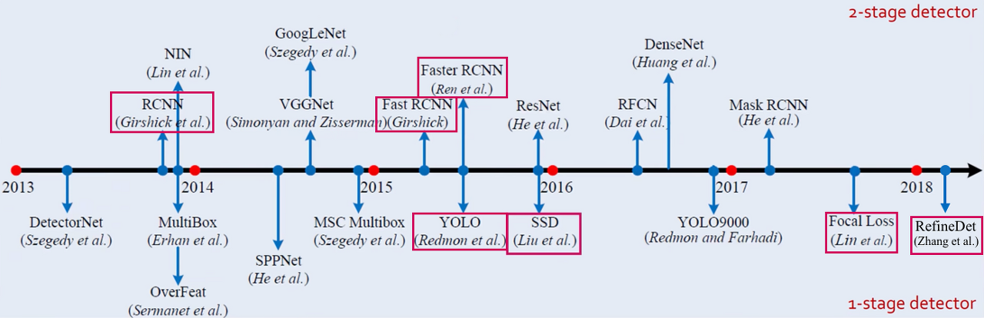
CNN Applications
Object Detection

Slide 30
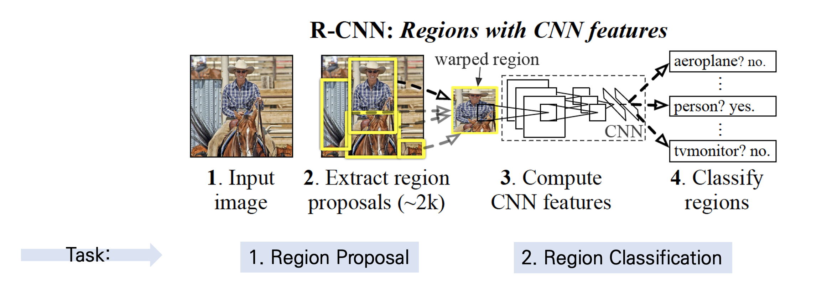
CNN Applications
Object Detection – RCNN based

Slide 31
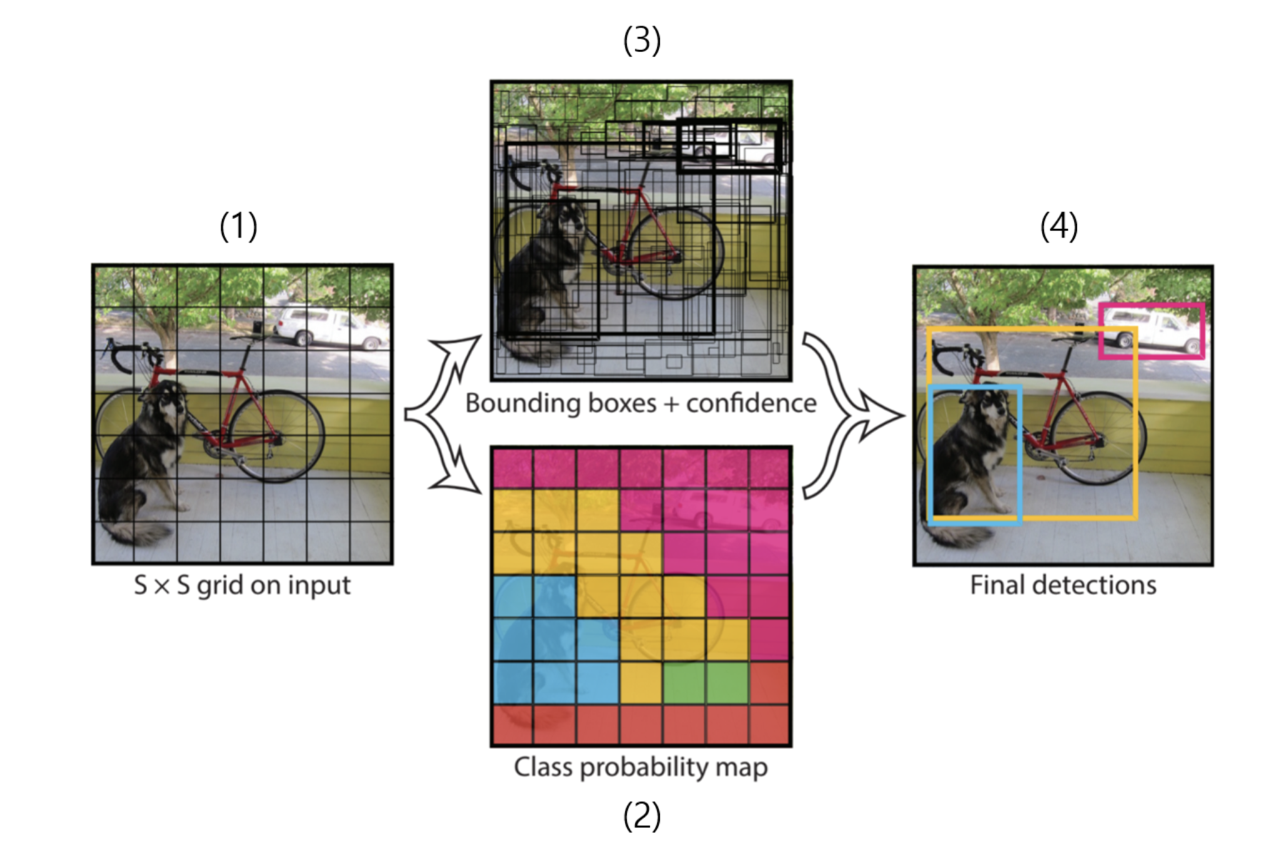
CNN Applications
Object Detection – YOLO based

Slide 32
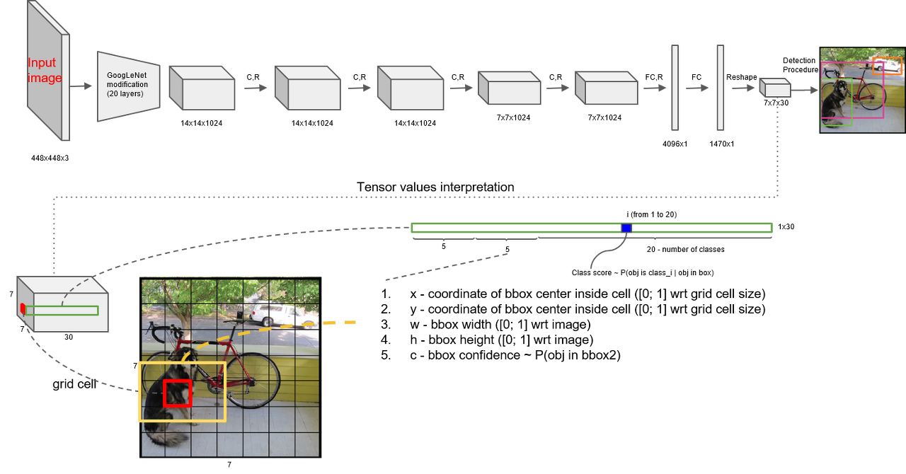
CNN Applications

Slide 33
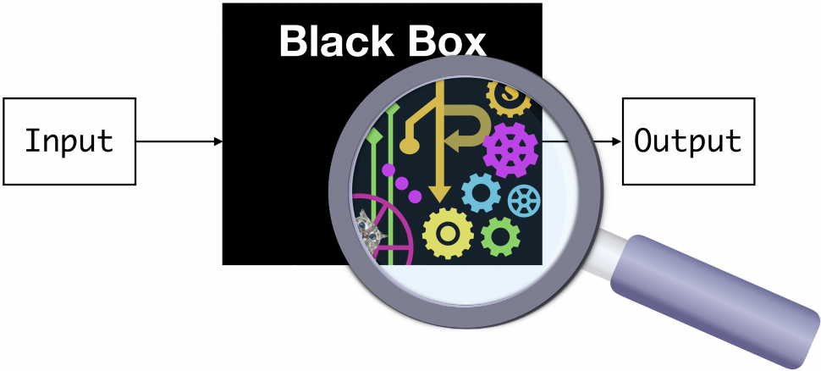
CNN Applications
Class Activation Map (2016)

Slide 34
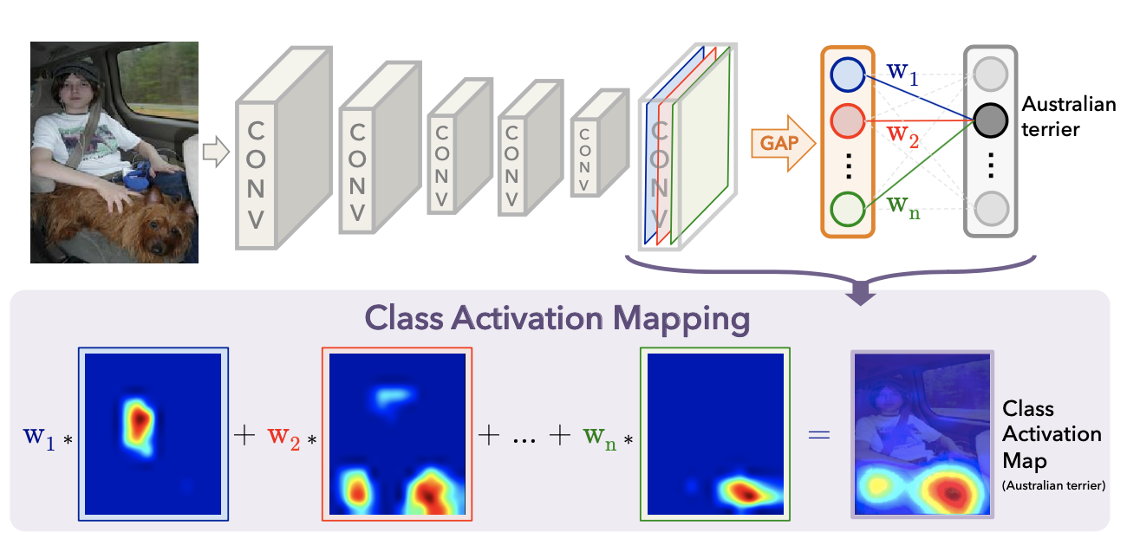
CNN Applications
Class Activation Map (2016)

Slide 35
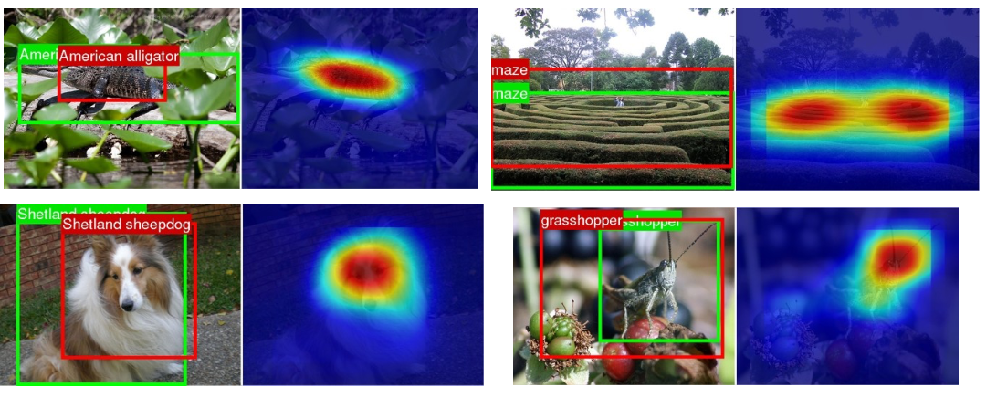
CNN Applications
Class Activation Map (2016)

Slide 36
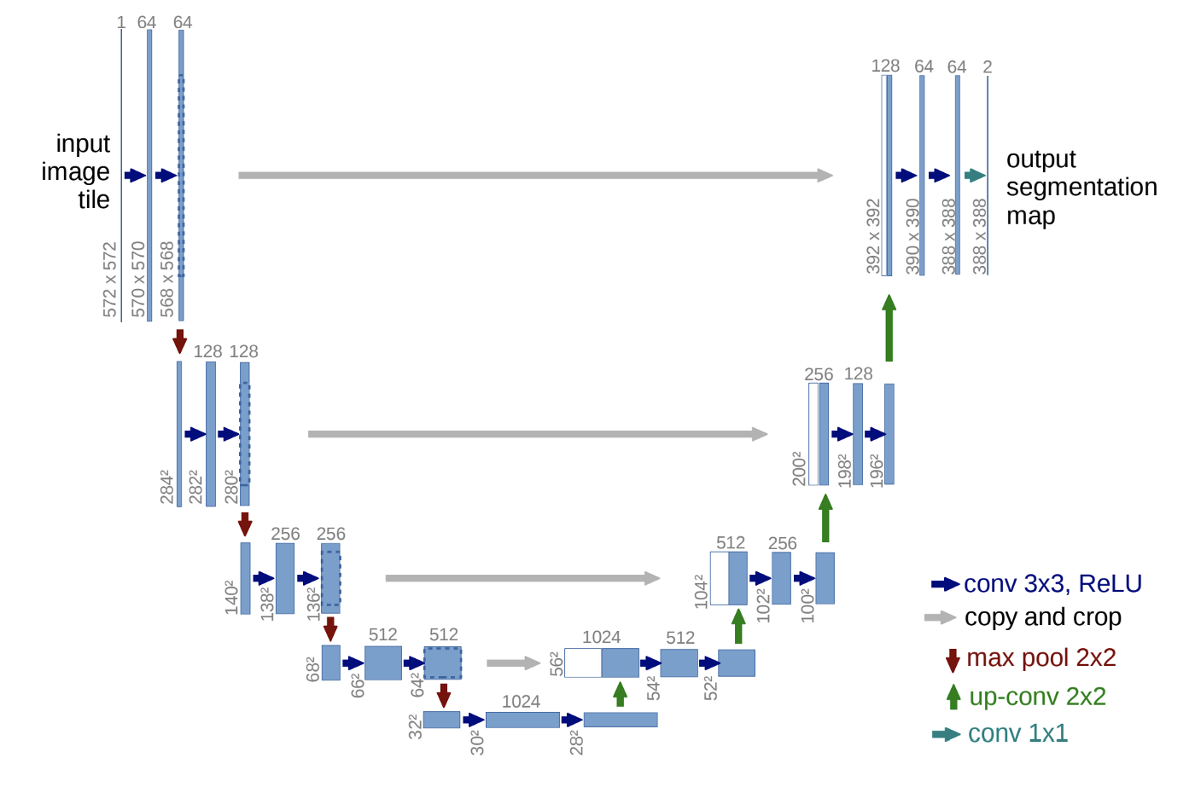
CNN Applications
U-Net (2015)

Slide 37
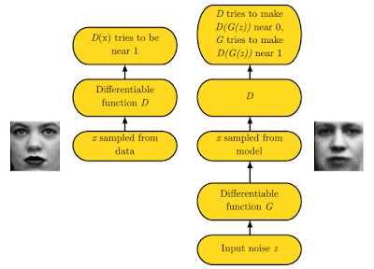
CNN Applications
GAN (2014)

Slide 38
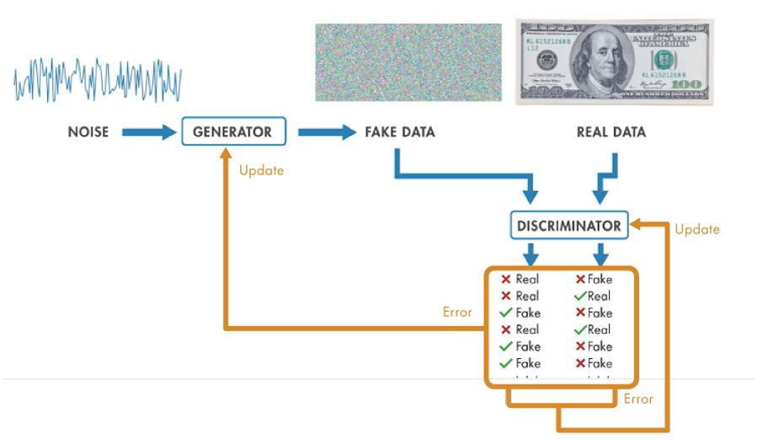
CNN Applications
GAN (2014)

Slide 39
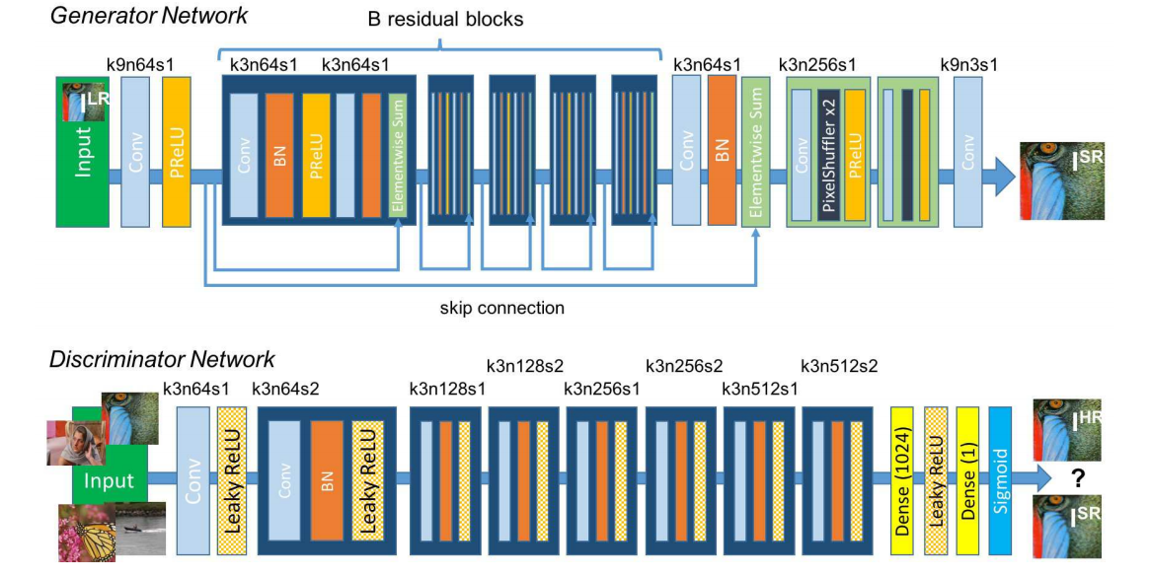
CNN Applications
SRGAN (2017)

Slide 40
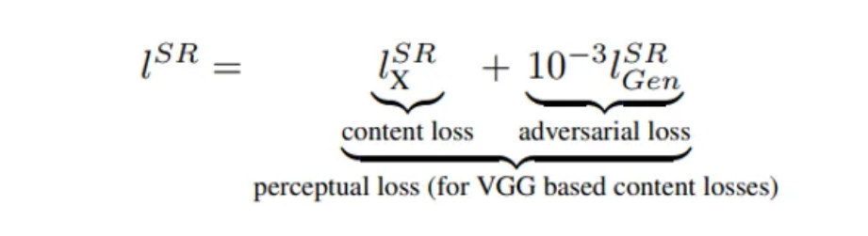
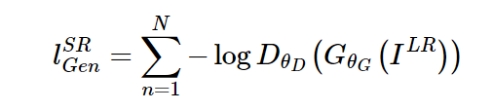
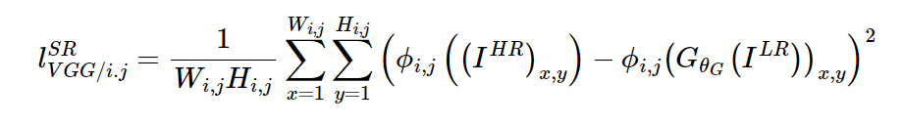
CNN Applications
SRGAN (2017)

Slide 41
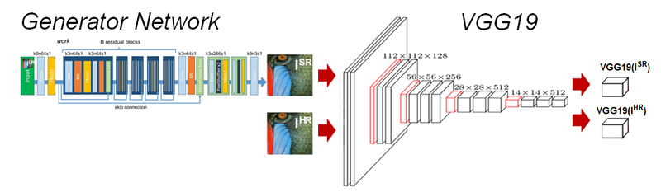
CNN Applications
SRGAN (2017)

Slide 42
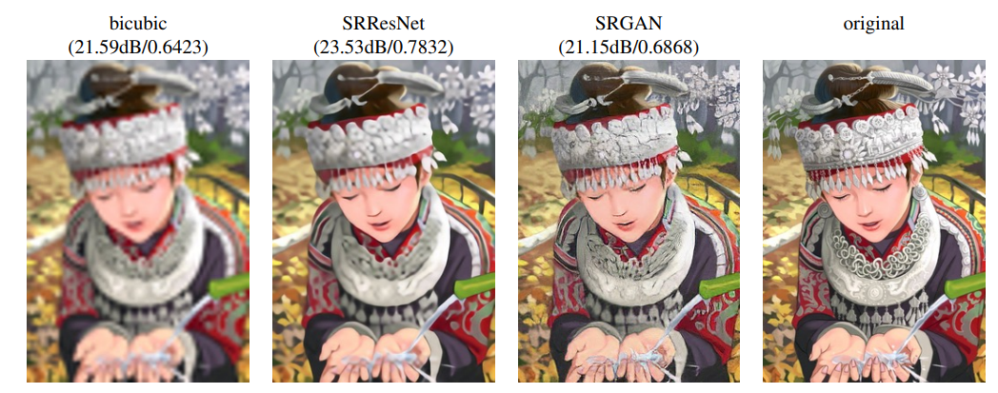
CNN Applications
SRGAN (2017)

